Slide 1
Module 5:
Mentoring

Slide 2
MODULE 5: Mentoring – UNITS (1 h 15 min)
Indro
Unit 5.3
Unit 5.1
Introduction to Mentoring
Growing into a mentor
  What is mentorship?
  Benefits
  Types of mentorships
  When is the right time?
  Core Competencies for Effective Mentorship
  Leading with Empathy & Awareness
  Tools & Techniques
  Helping mentees set and reach their goals
  Maintaining integrity in mentoring relationships
Unit 5.2
Becoming an Effective Mentee
  Why mentoring relationships are valuable for personal and professional growth
  How to identify your needs and goals as a mentee
  Finding the right mentor
  Skills for successful mentees

Slide 3
What You Will Gain in This Module?
Knowledge
You will understand:
The core purpose of mentoring - what it is (and what it is not) - and how it differs from coaching.
The personal and professional benefits of mentoring for both mentors and mentees.
The types of mentoring relationships and the contexts they are used.
Skills
You will be able to:
Set clear and realistic goals for mentoring.
Apply key interpersonal skills in mentoring interactions.
Identify and approach potential mentors aligned with your key values and goals.
Competence
You will be able to:
Build and sustain effective, respectful, and mutually beneficial mentoring relationships.
Actively engage as mentees and transition into mentoring roles with confidence and empathy.
Maintain ethical standards, emotional awareness, and inclusive practices in all mentoring activities.

Slide 4
UNIT 5.1: Introduction to Mentoring

Slide 5
Mentoring is about creating connections that help us discover new strengths and possibilities. In this unit, we'll explore how to be a great mentee -and how, when we are ready, we can become mentors too. Together, we will build the skills to motivate, guide, and support women 45+, creating a shared journey of learning and empowerment.

Slide 6
What mentoring is and what it is not
What mentoring is:
The mentor helps the mentee clarify their professional development goals and devise a plan to achieve them by sharing their experiences & knowledge, acquired during their own career. The main goal of the relationship is the mentee's professional development.

Slide 7
What mentoring is and what it is not
What mentoring isn't:
Mentoring is not training, consulting, or counselling that aims at supporting the mentee with personal issues. The mentor is not a guru and does not know everything but rather acts as a more experienced co-traveler who facilitates the mentee's professional development journey.

Slide 8
The difference between mentoring and coaching
In mentoring, a very important aspect of the process is the sharing of knowledge and experiences, from the mentor to the mentee. The mentee can request the mentor's opinion and feedback and the latter can respond to that request.
In coaching, the coach must remain objective and refrain from expressing their personal views and opinions or sharing their personal experiences. Coaches use specific methods and tools to assist the personal and professional growth of their coachees.

Slide 9
The difference between mentoring and coaching
In mentoring, mentors can come from different fields of work and different industries. In coaching, the coaches offer their services in a professional capacity.
Mentoring can become a long-term relationship, whereas coaching is (usually) more of a short-term relationship.

Slide 10
The benefits of mentoring
For the mentees
Increases your professional self-confidence
Helps you set clear professional goals
Contributes to a better understanding of the subject/industry that interests you
Helps you face professional challenges more effectively
Helps you evaluate better the opportunities that may be available and presented to you
Helps you develop soft skills like active listening, risk management, team management, negotiation and setting boundaries
For the mentors
Personal satisfaction for supporting people
Helps you gain a new insight/perspective on your own career path
Improvement of communication skills
Development of further collaboration skills
Development of giving and receiving feedback skills
Helps you become a more active listener

Slide 11
Types of mentoring
Traditional 1-on-1 mentoring
The classic mentoring approach, in which a mentor and mentee agree to form a mentoring relationship to help the mentee grow professionally or overcome a professional challenge they are facing.
Group mentoring
In a group mentoring setting, mentees are placed in small groups with a mentor who leads discussions and activities around a specific topic. In group mentoring, one or more mentors provide guidance and advice to several mentees, with aligned mentoring requests.

Slide 12
Types of mentoring
Peer-to-peer mentoring
Peer mentoring is a process where two people of similar age and/or experience, work together to help each other grow. The relationship is less formal than a traditional mentoring relationship, yet structured so that it’s mutually beneficial.
Reverse mentoring
Reverse mentoring occurs when a younger, less experienced person mentors a more senior person (in terms of age, experience or position). Reverse mentoring provides an opportunity to build relationships across generations and to support the growth of experienced professionals in certain issues they may lack knowledge in.

Slide 13
UNIT 5.2: Becoming an effective mentee

Slide 14
How to identify your needs and goals as a mentee
Your WHAT
What challenges are you facing?
What skills do you need to develop?
Which are the areas you feel stuck?
What are the changes you are trying to make?
WHAT is the one thing you want your mentor to support you with in your professional life right now?
And your WHY
Why is it important for you to focus on this?
If this skill is developed, what will you be better at?
If this challenge is faced, what will be different for you?
Understanding your WHY will help you stay motivated!

Slide 15

A reminder of how useful S.M.A.R.T. goal(s) (yes, in mentoring too!)
Specific | “With my mentor, I want to identify one key area I need to grow in order to be ready for the next promotion period in my company”.
Measurable | “We will identify key (small) milestones and set at least one action point between our meetings”.
Achievable | “We will plan according to my schedule and workload with very quick check in so that we can adapt if necessary (and won’t identify more that one key area!)”.
Relevant | “In order to identify this one key area, I will need to think how it compliments my current professional life or future vision”.
Time-bound | “My mentor and I will aim for me to complete my first milestone(s) before our [insert number] meeting”.
ATTENTION! Not all mentoring goals need to be super aligned with the S.M.A.R.T framework! Make the framework for you and don’t work your goals around the framework. It is here to guide you, not restrict you!

Slide 16

Finding the right mentor
Your mentor must have experience in the subject and/or field of your interest.
Example: If you want to make a career change and start your own business, the mentor you will choose needs to either have made a similar change, or be an entrepreneur in a similar field.
If you are interested in a particular field of support/challenge, then you can choose your mentor based on that.
Example: If you work in the maritime sector, and you need support in relation to working in a male-dominated environment, you can choose a mentor who has faced the same challenge even if she is in another industry, for example in the industry of technology.

Slide 17
Finding the right mentor
Make sure that you connect with people who may know other people that can help you find your right mentor.
Tip: Go to networking or community events around you or online, ask people for mentor’s recommendations, message people on LinkedIn explaining that they might be your ideal mentor but always be kind and respectful of other people’s time.
How would you prefer your mentoring meetings to happen?
Tip: f you’d prefer a mentor that you can meet with in-person, focus your research on areas close to you and make this your priority. If in-person meetings would be difficult for you to manage or you feel it would limit your choice of mentors, expand your research.

Slide 18
Skills for successful mentees
Active listening
During your meetings, listen carefully and attentively - not just waiting to respond, but to truly understand what your mentor is sharing. Avoid interrupting, put all your notifications on silent so that you minimise interruptions and don’t hesitate to take notes if it helps you. Active listening builds trust and shows respect for your mentor’s time (and yours!)
Goal setting and preparation
Before each meeting/contact (especially the first one), think about and choose what are the main professional issues that concern you, so that you are prepared and that you make the most of your discussion with your mentor (go back to the goal setting slide for more practical tips!)
Being open to feedback
Receiving feedback - especially when it challenges you - is a key part of growing through mentoring. Try to approach your mentor’s comments with curiosity rather than defensiveness. Ask questions and be willing to explore new perspectives, even when they feel uncomfortable at first.

Slide 19
Skills for successful mentees
Building trust and mutual respect
Respect the time limits you have already agreed to with your mentor. Do not expect them to be available
anytime you need them, outside the agreed plan.
Be honest and open about the issues that concern you. Your mentor is there to listen to you, and your
collaboration will be more fruitful if you show them trust.
Making the most of the mentoring relationship
Commitment is a key component to the mentoring process and it means:
Being consistent in your communications and appointments
Going to each of your meetings prepared
Following the steps you have agreed upon in between your meetings

Slide 20
UNIT 5.3: Stepping into the role of a mentor
The journey from personal growth to guiding others

Slide 21

When is the right time?
Recognizing internal and external signs of readiness to mentor in 3 steps
STEP 1: Recognize that you are ready to mentor
You’ve gained meaningful experience in your field or role.
Colleagues or peers seek your advice or input regularly.
You feel a desire to give back and support others’ growth.
You’ve overcome challenges and can share lessons learned.
You’re comfortable with not having all the answers, but willing to explore them with others.
Try this during the workshop and ​
write down the answers!​
STEP 2: Self reflection questions
What have I learned that could benefit someone else?
Do I enjoy helping others grow?
Am I patient and open to different perspectives?
Can I commit time and energy to someone else’s development?
STEP 3: Your growth mindset in mentoring
Mentoring is not about being perfect - it's about being willing to grow alongside your mentee.
Readiness is a mindset, not a milestone
Notes:
Speaker notes: Help participants reflect on their own readiness to mentor by identifying key indicators and internal motivations.

Slide 22




Core Competencies for Effective Mentorship
Active
Listening
Motivation & Empowering
Sharing Experience Constructively
Giving
Feedback
Notes:
Speaker notes:
Active Listening
Tools & Techniques:
SOLER Model (Egan): Encourages open body language and attentiveness: Sit squarely, Open posture, Lean in, Eye contact, Relax. the-soler-model-script.pdf
Reflective Listening: Repeat or paraphrase what the mentee says to confirm understanding.What is Reflective Listening? | A Definitive Guide
Ladder of Inference: Helps mentors avoid jumping to conclusions by examining their thought process.Ladder of inference | Untools
Motivating and Empowering Others
Tools & Techniques:
GROW Model (Goal, Reality, Options, Will): A structured coaching framework to help mentees set and achieve goals. The GROW Model of Coaching and Mentoring - A Simple Process for Developing Your People
Appreciative Inquiry: Focuses on strengths and what’s working well to inspire positive change.What Is Appreciative Inquiry? (Definition, Examples & Model)
StrengthsFinder or VIA Character Strengths: Tools to identify and leverage mentees’ natural talents.Gallup Clifton Strengths (Strengthsfinder): A Complete Guide - Mentorink, How is the VIA Survey Different from StrengthsFinder?
Sharing Experiences Constructively
Tools & Techniques:
STAR Method (Situation, Task, Action, Result): Helps mentors structure stories clearly and meaningfully.How to Use the STAR Interview Method Response Technique | Indeed.com Canada
Storytelling Frameworks (e.g., Hero’s Journey): Useful for sharing personal growth narratives that resonate. 3 Storytelling Frameworks I Am Using To Transform My Content Writing | by Nimra Khalid | The Writing Cooperative
Metaphor Coaching: Using metaphors to make abstract experiences relatable and memorable.The Power of Metaphors in Coaching
Giving Feedback
Tools & Techniques:
SBI Model (Situation, Behavior, Impact): A simple and effective structure for giving clear, non-judgmental feedback. Use SBI (Situation-Behavior-Impact) to Understand Intent | CCL
Feedforward (Marshall Goldsmith): Focuses on future improvement rather than past mistakes.Feedforward | No1 Approach To Seeking Ideas For Improvement
Radical Candor (Kim Scott): Balances caring personally with challenging directly. Radical Candor (Care Personally + Challenge Directly) | Bramlett Partners

Slide 23


Competence 1
Active Listening
Giving your full attention, asking thoughtful questions, making the mentee feel truly heard and understood.
Example
A mentee shares concerns about their performance in a new role.
The mentor listens actively - maintaining eye contact,
asking clarifying questions and paraphrasing to confirm understanding.
Follow-Up
The mentor reflects on how well they captured the mentee’s emotions and intentions.
Notes:
Speaker notes:​
Active Listening​
Tools & Techniques:​
SOLER Model (Egan): Encourages open body language and attentiveness: Sit squarely, Open posture, Lean in, Eye contact, Relax. the-soler-model-script.pdf​
Reflective Listening: Repeat or paraphrase what the mentee says to confirm understanding.What is Reflective Listening? | A Definitive Guide​
Ladder of Inference: Helps mentors avoid jumping to conclusions by examining their thought process.Ladder of inference | Untools​

Slide 24
Competence 2
Motivation & Empowering
A mentor inspires belief in a mentee’s potential and helps them see possibilities they may not yet recognize themselves.
Example
A mentee expresses doubt about applying for a leadership opportunity.
The mentor uses encouraging language, highlights the mentee’s strengths, and shares examples of similar challenges they’ve overcome.
Follow-Up
The mentor guides the mentee through a goal-setting conversation using the GROW model¹¹, helping them visualize success and act.
Notes:
Motivating and Empowering Others​
Tools & Techniques:​
GROW Model (Goal, Reality, Options, Will): A structured coaching framework to help mentees set and achieve goals. The GROW Model of Coaching and Mentoring - A Simple Process for Developing Your People​
Appreciative Inquiry: Focuses on strengths and what’s working well to inspire positive change.What Is Appreciative Inquiry? (Definition, Examples & Model)​
StrengthsFinder or VIA Character Strengths: Tools to identify and leverage mentees’ natural talents.Gallup Clifton Strengths (Strengthsfinder): A Complete Guide - Mentorink, How is the VIA Survey Different from StrengthsFinder?​

Slide 25
Competence 3
Sharing Experiences Constructively
Sharing your journey with honesty and humility helps mentees learn from your successes and your setbacks - without turning the conversation into a lecture.
Example
The mentee is struggling with managing team conflict.
The mentor shares a personal story using the STAR method¹⁴, describing a similar situation they faced, how they handled it, and what they learned.
Follow-Up
The mentor invites the mentee to reflect on how the story relates to their own experience and what strategies they might try.
Notes:
Sharing Experiences Constructively​
Tools & Techniques:​
STAR Method (Situation, Task, Action, Result): Helps mentors structure stories clearly and meaningfully.How to Use the STAR Interview Method Response Technique | Indeed.com Canada​
Storytelling Frameworks (e.g., Hero’s Journey): Useful for sharing personal growth narratives that resonate. 3 Storytelling Frameworks I Am Using To Transform My Content Writing | by Nimra Khalid | The Writing Cooperative​
Metaphor Coaching: Using metaphors to make abstract experiences relatable and memorable.The Power of Metaphors in Coaching​

Slide 26

Competence 4
Giving Feedback
Effective feedback is timely, specific, and focused on growth - it supports the mentee while challenging them to improve.
Example
After observing the mentee lead a team meeting, the mentor schedules a feedback session. Using the SBI model¹⁷, the mentor describes the situation, the specific behaviours observed, and the impact on the team.
Follow-Up
The mentor balances praise with suggestions for improvement and asks the mentee how the feedback felt and what they plan to do differently next time.
Notes:
Giving Feedback​
Tools & Techniques:​
SBI Model (Situation, Behavior, Impact): A simple and effective structure for giving clear, non-judgmental feedback. Use SBI (Situation-Behavior-Impact) to Understand Intent | CCL​
Feedforward (Marshall Goldsmith): Focuses on future improvement rather than past mistakes.Feedforward | No1 Approach To Seeking Ideas For Improvement​
Radical Candor (Kim Scott): Balances caring personally with challenging directly. Radical Candor (Care Personally + Challenge Directly) | Bramlett Partners​
​

Slide 27




Leading with Empathy & Awareness
What Is Emotional Intelligence (EI)?
Why EI Matters In Mentoring
Recognizing and managing your own emotions – and others’.
Key skills (Daniel Goleman’s model ²⁰): Self-awareness, self-regulation, motivation, empathy, social skills
Recognize your emotional triggers and biases (Self-Awareness)
Listen beyond words - notice tone, body language and context (Empathy)
Stay calm and supportive, even in tough moments (Regulation)
Communicate clearly and build strong connections (Social skills)
Applying EI In Mentoring
Tools & Techniques
Builds trust and psychological safety. Helps mentors respond, not react, in emotionally charged situations. Encourages deeper understanding of mentees’ needs, fears, and motivations.
Emotion Wheel: Explore this technique in slide 28
Mindfulness Practices: Short breathing or grounding exercise to stay present
Empathy Mapping: Explore this technique in slide 30
Journaling or Reflection: For both mentor and mentee to process emotional experiences

Slide 28
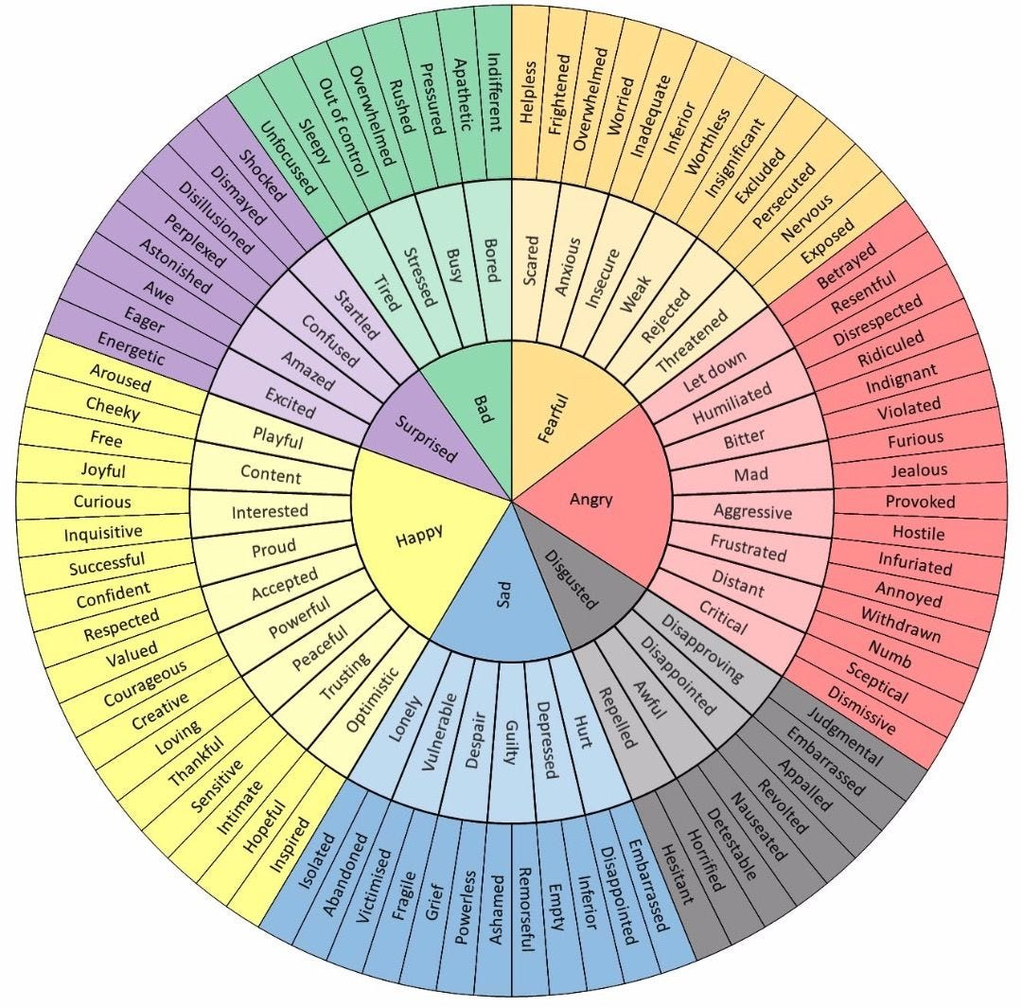
Emotion Wheel
The Emotion Wheel helps mentees identify and articulate their emotions more precisely, especially when they feel overwhelmed or unclear.

Slide 29




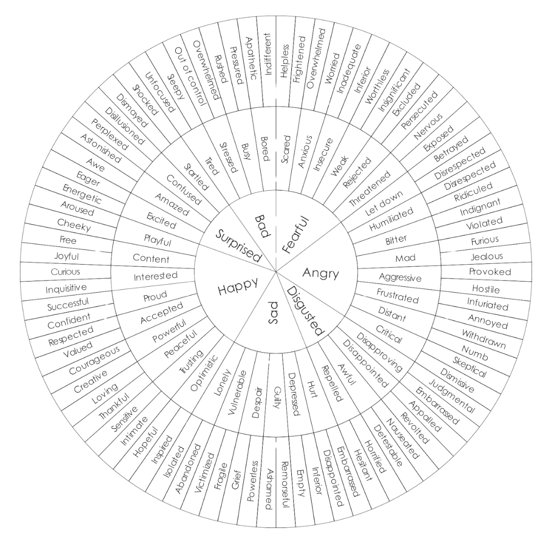

Emotion Wheel – How to use it as a mentor
Steps for mentors
Introduce the tool: “Sometimes it helps to name what we’re feeling. Let’s look at this wheel together.”
Start from the center: Ask the mentee to choose a basic emotion (e.g., sad, angry, happy).
Move outward: Help them narrow it down to a more specific feeling (e.g., from “angry” to “frustrated” or “resentful”).
Reflect: Ask, “What do you think is triggering this feeling?” or “How does this emotion effect your thinking or behaviour?”
Support: Use the insight to guide the conversation or adjust the sessions focus.

Slide 30
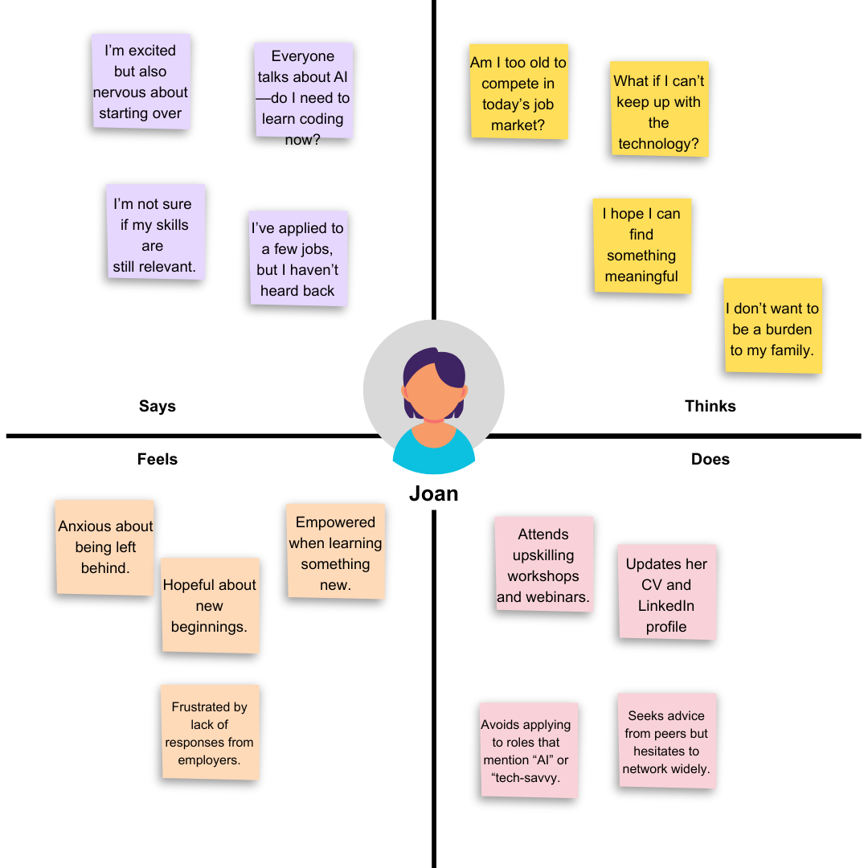
Empathy Mapping
Empathy Mapping helps mentors understand the mentee’s experience from multiple angles, especially when they are stuck of facing a challenge

Slide 31




Empathy Mapping – How to use it in mentoring
Steps for mentors
Draw or share the map with four quadrants
What they SAY
What they THINK
What they DO
What they FEEL
Ask guiding questions
“What have you been saying about this situation?
“What thoughts are running through your mind?”
“What actions have you taken?”
“What emotions are you experiencing?”
Fill it in together: Use sticky notes or a shared document
Analyse patterns: Look for disconnects (e.g. saying “I’m fine” but feeling anxious)
Use insights to tailor your support and help the mentee reframe or plan next steps.

Slide 32

When collaborating on goals, ask questions like
Helping mentees set and reach their goals
“What do you want to learn or improve?”
“What challenges do you want to address?”
"Where do you see yourself in 6 months?"
Setting Goals in Mentoring
Setting goals is essential in mentoring. They provide direction, keep mentees motivated, and allow both mentor and mentee to track progress.
Collaborating on Goals
Mentors work with mentees to define goals, reflecting on what they want to achieve, where they see themselves in 6 – 12 months, and obstacles they wish to overcome. Co-create goals to ensure ownership and alignment.
Tools & Frameworks
Use structured tools such as SMART goals (slide 15) or a personalized development plan to clarify objectives and focus on actionable steps.
Tracking Progress and Staying Accountable
Regular check-ins, celebrating small wins, and encouraging self-reflection help mentees stay accountable and adapt goals as they grow.
Notes:
The GROW Model of Coaching and Mentoring - A Simple Process for Developing Your People
Creating a Personal Development Plan with Your Mentor — Thrive with Mentoring

Slide 33
Maintaining integrity in mentoring relationships
Protect Confidentiality & Build Trust
Mentors must safeguard private information shared by mentees and create a safe space for open dialogue, disclosing only when legally or ethically required.
Define Roles & Set Clear Expectations
Clarify the purpose, scope, and limits of the mentoring relationship early on to avoid confusion and ensure mutual understanding.
Maintain Healthy Boundaries & Avoid Dependency
Establish limits around time, emotional involvement, and decision-making to support the mentee’s independence and prevent over-reliance.
Respect Differences & Practice Inclusion
Mentors should be culturally sensitive, open-minded, and avoid imposing personal values, ensuring the relationship is respectful and inclusive.
Act with Integrity & Transparency
Be honest about your capabilities, avoid dual roles or conflicts of interest, and model ethical behavior in all interactions.
Know When to Refer or Step Back
Recognize when a mentee’s needs go beyond your expertise—such as mental health or legal issues—and guide them to appropriate professional support.

Slide 34
References
[1] WHEN, Be My Help Handbook. [Online]. Available: https://when.org.gr/wp-content/uploads/2025/01/ENG_Be-My-Help-Handbook.pdf
[2] WHEN Mentoring Platform, “FAQ for Mentors,” [Online]. Available: https://mentoring.when.org.gr/faq/for-mentors
[3] WHEN Mentoring Platform, “FAQ for Mentees,” [Online]. Available: https://mentoring.when.org.gr/faq/for-mentees
[4] WHEN Mentoring Platform, “Mentoring in General – FAQ,” [Online]. Available: https://mentoring.when.org.gr/faq/mentoring-in-general
[5] University of Cambridge, Mentoring Guide 2020 (v3). [Online]. Available: https://www.ppd.admin.cam.ac.uk/files/mentoring_guide_2020_v3.pdf
[6] Guider, “Types of Mentoring,” Guider Blog. [Online]. Available: https://guider-ai.com/blog/types-of-mentoring/
[7] Together Platform, Mentor Handbook. [Online]. Available: https://www.togetherplatform.com/handbook/mentor

Slide 35
References
[8] Stockton, SOLER Model (Egan). [Online]. Available: https://www.stockton.ac.uk/media/3545/the-soler-model-script.pdf
[9] The Colin James Method, "What is Reflective Listening? A definitive Guide," [Online]. Available: https://colinjamesmethod.com/what-is-reflective-listening/
[10] Untools, "Ladder of Inference," [Online]. Available: https://untools.co/ladder-of-inference/
[11] Mindtools, "The GROW Model of Coaching and Mentoring," [Online]. Available: https://www.mindtools.com/an0fzpz/the-grow-model-of-coaching-and-mentoring
[12] PositivePsychology, "What is Appreciative Inquiry?," [Online]. Available: https://positivepsychology.com/appreciative-inquiry
[13] Mentorink, "Gallup Clifton Strengths," [Online]. Available: https://www.mentorink.com/blog/gallup-clifton-strengths-strengthsfinder-a-complete-guide/#:~:text=Improved%20Career%20and%20Personal%20Development%20By%20aligning,more%20effective%20for%20long%2Dterm%20growth%20and%20happiness.

Slide 36
References
[14] Indeed, "How to use the STAR interview method," [Online]. Available: https://ca.indeed.com/career-advice/interviewing/star-interview-method
[15] Medium, "3 Storytelling Frameworks," [Online]. Available: https://writingcooperative.com/3-storytelling-frameworks-i-am-using-to-transform-my-content-writing-8433c83ce87e
[16] Nordic Coach and NLP Academy, "The Power of Methaphors in Coaching," [Online]. Available: https://nordicnlp.com/2025/02/27/the-power-of-metaphors-in-coaching/
[17] Center for Creative Leadership, "Use Situation-Behaviour-Impact (SBI)™ to understand intent," [Online]. Available: https://www.ccl.org/articles/leading-effectively-articles/closing-the-gap-between-intent-vs-impact-sbii/
[18] Marshall Goldsmith, "Feedforward | No1 Approach To Seeking Ideas For Improvement," [Online]. Available: https://www.nlp-techniques.org/what-is-nlp/nlp-planning/nlp-feedforward/

Slide 37
References
[19] Bramlett Partners, "Radical Candor (Care Personally + Challenge Directly)," [Online]. Available: https://bramlettpartners.com/blog/radical-candor-care-personally-challenge-directly
[20] TSW Training, "Daniel Goleman’s Emotional Intelligence in Leadership," [Online]. Available: https://www.tsw.co.uk/blog/leadership-and-management/daniel-goleman-emotional-intelligence/

Slide 38
THANK YOU!

