Slide 1
Module 4:
Learning Strategies

Slide 2
MODULE 4: Learning strategies – UNITS (1h)
Unit 4.1
Unit 4.3
Learning styles
Things to avoid: Procrastination
  What are learning styles?
  Identifying and combining styles
  The Procrastination cycle
  Consequences og procrastination and what to do
  How to fight procrastination
Unit 4.2
Unit 4.4
Study techniques
Things to avoid: Distractions
  Active recall
  Mind maps
  Pomodoro
  Combining techniques
  External distractions
  Internal distractions
  Managing distractions
Notes:
NOTE for the facilitator: This module shows how people learn in different ways.
It gives simple methods to remember better and stay focused, like Active Recall, Mind Maps, and the Pomodoro Technique.
It also talks about problems like procrastination and distractions, and how to deal with them.

Slide 3
What You Will Gain in This Module?
Knowledges
Different learning styles
Key study techniques (Active Recall, Mind Maps, Pomodoro)
Nature of procrastination and distractions
Skills
Apply study techniques effectively
Manage time and focus
Identify personal learning style
Develop strategies to overcome procrastination
Competences
Autonomy in learning
Consistency in study habits
Lifelong learning strategies
Ability to adapt methods to personal needs

Slide 4
UNIT 4.1: Learning styles

Slide 5
What are learning styles?
Each person has natural preferences in the way they process information:
Visual: learn best through images, diagrams, graphs and colors.
Auditory: retains information by listening to explanations, debates, or recordings.
Kinesthetic: learns by doing, experimenting and using the body in the process.
Recognizing the preferred style allows you to maximize learning potential.

Slide 6
Identifying and combining styles
Identifying my style
Practical self-assessment:
Do I prefer to underline and make visual summaries? → Visual.
Do I need to hear explanations out loud to understand better? → Auditory.
Do I only fully understand when I perform or practice? → Kinesthetic.
Suggested exercise: recall a recent learning situation and identify which of these methods was most effective.

Slide 7
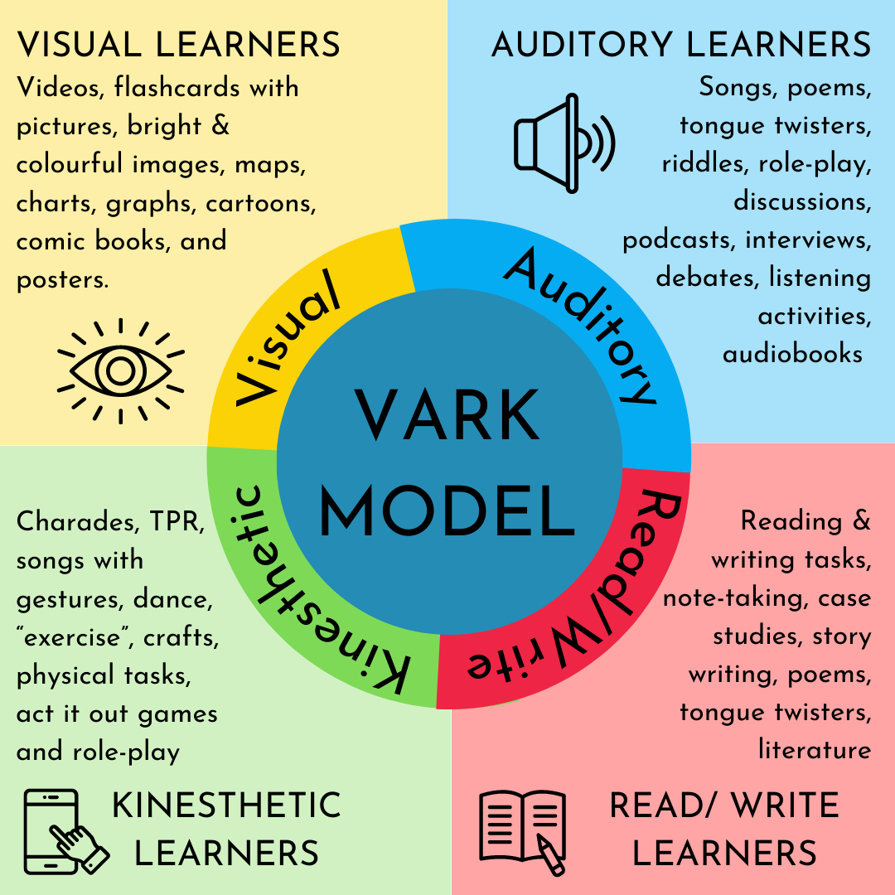
Use Combo Styles
While each person has a predominant style, multimodal learning (using multiple styles together) increases retention and motivation.
Practical example: Study a concept by reading a text (visual), recording and listening to an explanation (auditory), and applying it in a practical exercise (kinesthetic).
Image source: https://esl-curriculum.com/

Slide 8
UNIT 4.2: Study techniques

Slide 9

Technique: Active Recall
Active Recall is the practice of retrieving information from memory without consulting notes or textbooks.
Example: After finishing a chapter, close the book and write down or explain aloud everything you can remember.
Benefits: It strengthens long-term memory, enhances comprehension, increases confidence, and better prepares you for exams and assessments.

Slide 10

Technique: Mind Maps
A Mind Map is a visual tool that organises ideas in a hierarchical and branching structure.
Example: Place the central theme in the middle, add keywords around it, and create branches for examples and supporting details.
Benefits: It increases clarity, stimulates creativity, improves memory, and facilitates the visualisation of connections between concepts.

Slide 11
Technique: Pomodoro
It is a time management method that consists of studying or working in blocks of 25 minutes of intense concentration (during this time, it is forbidden to check your mobile or speak with another person), followed by a short 5-minute break. After four blocks (called "pomodoros"), a longer break is taken, from 15 to 30 minutes. The technique helps to increase focus, combat procrastination, and improve productivity and motivation.
Steps:
25 minutes of intense focus on a task.
5 minutes pause.
After 4 cycles, take a longer break (15–30 minutes).

Slide 12

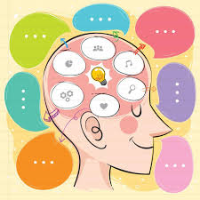
Combining techniques
The techniques can be used together:
Read a text → create a mind map.
Test what you remember (Active Recall)
Organize sessions with the Pomodoro Technique

Slide 13
UNIT 4.3: Things to avoid: Procrastination

Slide 14
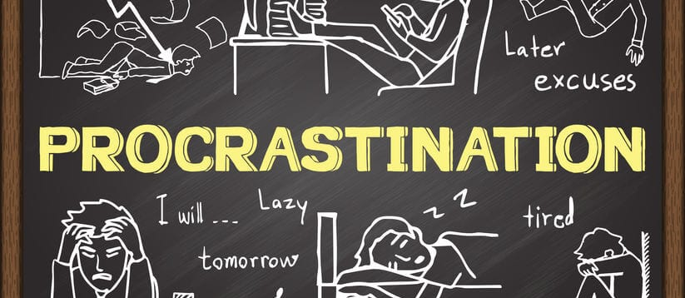
Things to avoid: Procrastination

Slide 15
The Procrastination Cycle
Procrastination is putting off important tasks by doing easier or more enjoyable ones instead — like cleaning your room instead of studying.
Task appears – You know you must do something (study, work, etc.).
Anxiety kicks in – Just thinking about it makes you feel stressed or unmotivated.
You delay it – To escape discomfort, you distract yourself with something easier (social media, Netflix, tidying up).
Temporary relief – You feel better for a moment because you’ve avoided the hard task.
Guilt and pressure – Time slips away, deadlines approach, and frustration builds.
More anxiety – The weight grows, making you want to postpone again.
➡️ Result: You get stuck in a vicious cycle — the more you delay, the worse you feel.

Slide 16
Consequences of procrastination and what to do
Example of Procrastination | Consequence | What to Do Instead
Delaying studying until the night before an exam | Poor performance, high stress, lack of sleep | Create a study timetable, break material into small parts, and review daily
Putting off a work project until the deadline | Lower-quality work, missed deadlines, pressure from manager | Divide the task into smaller steps, set mini-deadlines, use productivity tools (e.g. Pomodoro)
Avoiding exercise regularly | Poor physical health, low energy, guilt | Schedule exercise like an appointment, start with 10 minutes a day
Not replying to important emails | Missed opportunities, reputation damage | Set fixed times each day to check and answer emails
Postponing personal goals (e.g. learning a language, saving money) | Stagnation, regret, feeling stuck | Set SMART goals (Specific, Measurable, Achievable, Relevant, Time-bound) and track progress

Slide 17
How to fight procrastination
Problem | What Usually Happens | What To Do Instead
Tasks feel too big | You avoid starting because it looks overwhelming | Break it into smaller steps and focus on the first action
Waiting for motivation | You keep postponing, hoping to “feel ready” | Start anyway – action creates motivation
Easily distracted | Social media, TV, or tidying take over | Use time-blocking or the Pomodoro technique (25 mins focus + 5 mins break)
Fear of failure | You delay because you’re worried about not doing well | Focus on progress, not perfection; celebrate small wins
Low energy | You procrastinate because you feel tired or unfocused | Improve sleep, eat well, and schedule demanding tasks for your peak energy hours
Lack of deadlines | Open-ended tasks never get done | Set personal deadlines and make yourself accountable (tell a friend or colleague)

Slide 18
UNIT 4.4: Things to avoid: Distractions

Slide 19
Things to avoid: Distractions
External distractions
An external distraction is any outside factor that interrupts your focus, such as noise, messages, people, or environmental clutter. These come from the surroundings, not from your own thoughts or emotions.
Distraction | What to Do
Mobile phone | Silence notifications or keep it out of reach
Social media | Set time limits or log out while studying
Noise | Use earplugs or headphones with soft music
Other people | Agree quiet times or use “do not disturb”
Messy space | Tidy desk/room before starting work
Emails/messages | Check at set times, not constantly
Unexpected events | Plan short pauses, then return to the task

Slide 20
Internal distractions
An internal distraction is any interruption that comes from within yourself – such as thoughts, emotions, tiredness, or lack of motivation – that prevents you from concentrating fully on the task at hand.
Distraction | What to Do
Daydreaming | Bring focus back with short notes or reminders
Negative thoughts | Challenge them and replace with positive self-talk
Stress or anxiety | Use breathing exercises or short relaxation breaks
Lack of motivation | Break tasks into smaller steps and reward progress
Tiredness | Rest properly, take short naps, or adjust schedule
Overthinking | Write worries down and return to the task later

Slide 21
References
[1] European Commission, "Learning to learn competence," 2023. https://ec.europa.eu/education/
[2] Vanderbilt University Center for Teaching, "Bloom’s Taxonomy," 2024. https://cft.vanderbilt.edu/guides-sub-pages/blooms-taxonomy/
[3] VARK Learn Limited, "The VARK Modalities," 2024. https://vark-learn.com/
[4] VARK Learn Limited, "The VARK Questionnaire," 2024. https://vark-learn.com/the-vark-questionnaire/
[5] H. Pashler, M. McDaniel, D. Rohrer, and R. Bjork, "Learning styles: Concepts and evidence," Psychol. Sci. Public Interest, vol. 9, no. 3, pp. 105–119, Dec. 2008. https://www.psychologicalscience.org/journals/pspi/PSPI_9_3.pdf
[6] H. L. Roediger III and A. C. Butler, "The critical role of retrieval practice in long-term retention," Trends Cogn. Sci., vol. 15, no. 1, pp. 20–27, Jan. 2011. https://www.apa.org/pubs/journals/releases/amp-66-8-764.pdf
[7] T. Buzan, "Mind Mapping," 2024. https://www.mindmapping.com
[8] F. Cirillo, "The Pomodoro Technique," 2024. https://francescocirillo.com/pages/pomodoro-technique

Slide 22
References
[9] European Commission, "EPALE - Electronic Platform for Adult Learning in Europe," 2024. https://epale.ec.europa.eu/
[10] American Psychological Association, "Procrastination Research," 2010. https://www.apa.org/news/press/releases/stress/2010/procrastination
[11] P. Steel, "The nature of procrastination: A meta-analytic and theoretical review of quintessential self-regulatory failure," Psychol. Bull., vol. 133, no. 1, pp. 65–94, Jan. 2007. https://doi.org/10.1037/0033-2909.133.1.65
[12] American Psychological Association, "Tips on beating procrastination," 2010. https://www.apa.org/gradpsych/2010/11/procrastination
[13] Mind Tools Ltd, "Managing External Distractions," 2024. https://www.mindtools.com/
[14] J. Kabat-Zinn, "Mindfulness for Beginners," 2024. https://www.mindful.org/
[15] Harvard Business Review, "Focus Management," 2024. https://hbr.org/
[16] European Commission, "Lifelong Learning," 2024. https://epale.ec.europa.eu/

Slide 23
THANK YOU!

