Slide 1
Module 2:
Own Skills and Needs

Slide 2
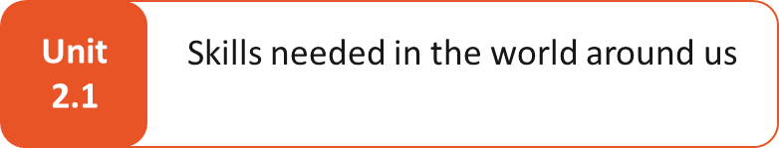
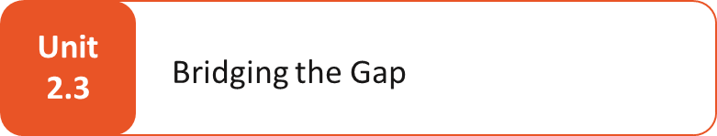
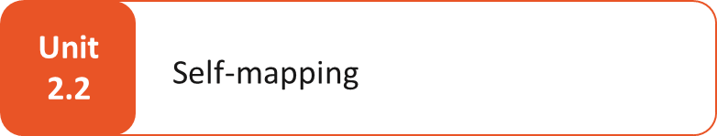
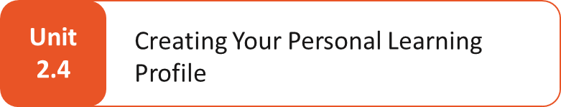
MODULE 2: Own Skills and Needs – UNITS (1h 15 min)
Research in one or more relevant sectors for the participant
Exploring current and future skill demands
Explore about sectors with skills shortage
Needs in digital and green sectors
Compare own skills with needs on the sector
Identify areas for development
Type of skills
Sources of skills
From experience to skills
Design your own profile

Slide 3
What You Will Gain in This Module?
Knowledge – Facts, concepts and information acquired through learning and study.
Example: understanding renewable energy policies or knowing the formulas in Excel.
Skills – The ability to apply knowledge in practice, often demonstrated through performance.
Example: creating an Excel spreadsheet with formulas to analyse costs
Competences- The broader integration of knowledge, skills and attitudes (mindset/behaviours) to perform effectively in real-life contexts.
Example: managing a renewable energy project team by combining technical expertise, problem-solving skills, and the ability to guide and motivate others.

Slide 4
UNIT 2.1: Skills needed in the world around us

Slide 5

What are skills and why do they matter?
We talk about “skills”, but what does that really mean? Skills are the things you know how to do. They can come from jobs, volunteering, daily life, or learning.
Some are technical (like using a tool or a computer). Some are transferable (like communication or problem-solving). Some are “soft” (like being patient or working well in a team).
Future workforce models highlight why skills are essential:
1.Distributed workforce: skills in digital collaboration, cultural intelligence, and remote coordination.
2.Hybrid workforce: skills in adaptability, time management, and using hybrid communication tools.
3.Digital nomad workforce: skills in self-resilience, virtual networking, and digital entepreneurship.

Slide 6
Why are skills important today?
The world of work is changing. Some jobs disappear, and new ones appear. Many sectors (like green energy, care, or digital services) are growing fast.
Understanding what skills are needed today can help you:
Discover new possibilities
Feel more confident about your strengths
Plan your next steps, whether it is joining a training, starting something new, or finding work that suits you.
Prepare for the future of work; where jobs will be more remote, flexible, and digital, requiring to be self-driven, proactive, and adaptable.

Slide 7
Renewable energy sector as our example… Why?
It is growing fast:
Europe is aiming to become carbon neutral by 2050. This means more jobs in wind, solar and energy storage.
There is a need for people:
Many companies are looking for skilled workers, like solar panel installers and engineers.
It combines green and digital skills:
You will find both tech tools (like sensors or monitoring systems) and sustainability knowledge.
Digital tools, such as SCADA (systems that help monitor and control energy use) and IoT (smart sensors), are key in this sector.
Knowledge you can transfer:
Project planning, communication, data handling, all these are useful across other fields too.
It is locally relevant:
Many HERA regions already have renewable energy projects, which could offer training or job links.

Slide 8
Key skills demand by 2030
Technical skills:
Working with solar and wind technologies
Using energy storage systems
Understanding smart grids (digital energy networks)
Digital and data skills (use of tools like SharePoint, Jira, Miro, Whiteboards, Zoom, Teams)
Data analysis
Basic programming and automation
Cybersecurity awareness
Project & policy knowledge:
Planning and managing projects
Understanding basic rules and regulations in the energy sector
Sustainability knowledge:
Life cycle analysis (measuring the full impact of a product)
Carbon accounting (tracking emissions)

Slide 9

Anticipating future skill needs in green sector
Green energy systems: installing and maintaining solar/wind equipment
Battery storage: designing &managing large scale energy batteries(e.g. how solar power can be stored for use at night)
Smart-grid connection: integrating renewable power into intelligent networks
Green hydrogen & carbon rules: understanding new clean-energy regulations
Dashboards & data analytics: interpreting data to support decisions
AI-supported tools: applying AI in daily tasks
Sustainability & circular economy: promoting efficient use of resources
Reuse & eco-design: creating products with recycling and reusability in mind
Understanding energy policies & subsidies: navigating rules and incentives that shape the sector
Digital tools & automation: using software to streamline processes

Slide 10
UNIT 2.2: Self-mapping

Slide 11

What is self-mapping?
Self-mapping is a creative way to reflect on your knowledge, skills and experiences.
You create a personal “map” that shows your past roles, the skills you have gained, and your future goals.
It helps you see where you are now — and where you might want to go next.

Slide 12
Types of skills to map and sources of your skills
What kind of skills you can map
Technical skills (e.g., using Excel, operating a machine)
Transferable skills (e.g., teamwork, problem-solving, project planning)
Soft skills (e.g., being flexible, good listener, staying calm under pressure)
New skills you are developing (e.g., what you are learning in HERA Labs)
Where your skills come from
Jobs you had (e.g., office work, retail, caregiving)
Volunteer or community roles (e.g., helping at school events, peer mentoring)
Education & training (e.g. ,workshops, online courses, diplomas)
Everyday life (e.g., planning family events = organising skills; blogging = communication)

Slide 13
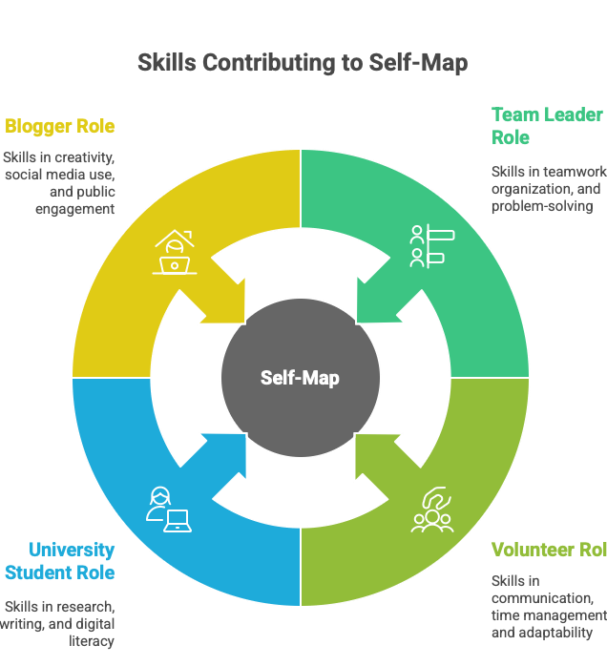
Self-mapping exercise
Centre ‘’You’’: Place yourself at the centre (write your name or use a sticky note).
Radiating nodes: Around yourself, place bubbles for each major experience or role
Life to skills: From each bubble, draw branches labelled with the specific skills gained
Milestones and goals: Mark future-oriented ‘’memes’’ or milestones toward your end-goal

Slide 14
UNIT 2.3: Bridging the gap

Slide 15

Understanding the skills gaps and the power of self-evaluation
Understanding the skills gaps: Skills gaps can be defined as the disparity between the skills that employers demand and the skills that their employees possess. These gaps are becoming increasingly apparent in the digital age, as the emergence of new technologies and the evolution of business models are continually redefining job roles.
The power of self-evaluation: Self-evaluation is a potent tool that can aid in identifying and addressing these skill gaps. Regular self-evaluation not only keeps individuals abreast with changing industry requirements but also signals their adaptability to potential employers, thereby enhancing job prospects.

Slide 16

How to identify and address your skills gaps
Here are some simple steps that can help you compare your skills with what is needed and plan your next actions.
Self-reflection and awareness
Stay informed about industry trends
Develop a picture of future success
Conduct a skills audit; make a list of your current skills and compare them to job ads
Embrace continuous learning
Develop a personalised learning plan
Practice and apply your skills; volunteer or take part in a project
Seek support and feedback(e.g. share your plan with a mentor )
Monitoring your progress.

Slide 17
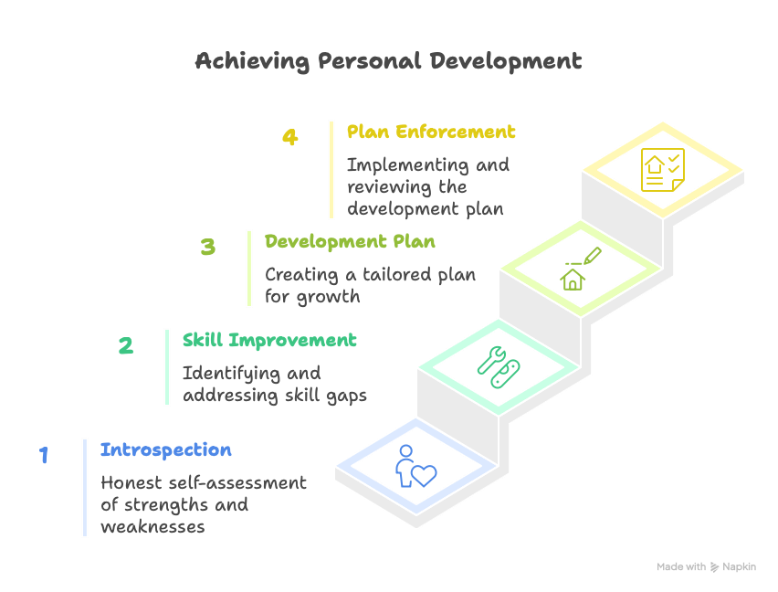
Steps for effective self-mapping

Slide 18

What to ask yourself…
Step 1- Recognising strengths and weaknesses:
What are my strengths and weaknesses in my current role?
Are these specific tasks or responsibilities I struggle with?
Do I feel confident in using the latest tools and technologies related my job?
Have I received feedback from peers, superiors, or clients about areas where I could improve?
Am I up to date with industry trends and best practices?
Step 2- Identifying skill gaps and Step 3- Creating a plan:
What does success look like for me?
If my career progressed perfectly in the next 12 months what would be different?
What are the skills and qualifications required for my role or the one I aspire to? How do they compare with my existing ones?
How can I bridge the gaps identified?... Outline your goals, the specific skills you want to develop and the timeline for achieving them.

Slide 19
Our innovative approach…The gap-analysis matrix
Sector-Required Skill | You Have It? (Y/N) | Proficiency Level (1–5) | Development Priority (High/Med/Low)
How to use:
List top 5-8 skills you already have.
Mark ‘’Y’’ if you already posses it; ‘’N’’ if not.
Rate your proficiency (1=novice, 5=expert).
Assign a priority based on business impact and personal interest.
Step-by-step comparison
1. Select skills: Choose the critical skills your target sector demands.
2. Self-assessment: Rate your own proficiency and experience against these sector skills.
3. Mark gaps: Any skill with an ‘’N’’ or proficiency <3 is a gap.
4. Review results: See which gaps are high-priority for your career path.

Slide 20
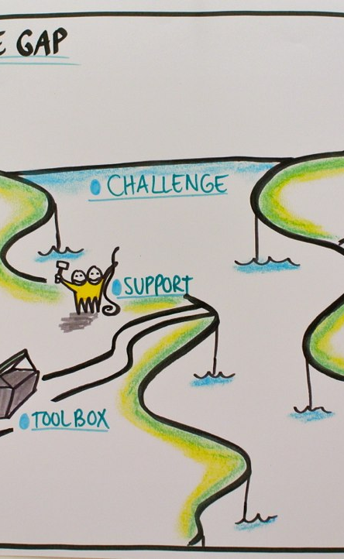
Gap-bridging exercise
Task: Complete the gap-analysis matrix for your chosen sector (e.g. renewable energy)
Group work: In pairs, compare matrices and discuss:
Which high-priority gaps surprised you?
What quick wins (low-hanging fruit) can you start immediately?
Which medium/high skills require longer-term plans?
Output: Each pair shares their top 2 development priorities with the group

Slide 21
UNIT 2.4: Creating your personal learning profile

Slide 22
What is a personal learning profile?
A snapshot of ‘’you as learner’’, combining:
Strengths and skills you have mapped
Interests and motivations
Barriers and supports you need
Key components of your profile:
Skills and experiences: highlight top technical, transferable and soft skills
Learning preferences: How you prefer to learn (workshops, video, hands-on)
Goals and aspirations: Short-term and long-term
Potential barriers: Time constraints, digital access and confidence gaps
Support strategies: Mentors, peer groups and digital tools

Slide 23

Building the profile-process
1.Gather your materials
Your skills, your goals, and what the market needs
2. Choose a format that suits you
You can use a Word document, a PowerPoint slide, a mind map, or even a short video. Whatever feels easiest.
3. Fill in each section
Use guiding questions (like “What are my top skills?” or “What support do I need?”) to complete each part of your profile.
4. Share and refine
Share your draft with a peer or trainer. Get feedback and make changes if needed.
5.Review and refine
Update your profile whenever you gain new skills, face new challenges, or set new goals.

Slide 24

Tools you can use to create your learning profile
You can choose the format that works best for you. There is no single correct way, just what feels most useful and natural.
Template (PowerPoint or Word): Use a file with sections for your skills, goals, preferences and support needs.
Mind-mapping apps: Use online tools like Miro, MindMeister. Draw or create a visual map showing your skills and learning direction.
Video tools: Explain your profile by speaking and recording a short message with your phone or computer.
Peer sharing: Exchange and discuss your profile with someone you trust to get feedback and new ideas.
Your learning profile is a tool you can return to, update, and use as you grow.

Slide 25
References
[1] N. Anae, "Self-Mapping: The Power of Self-Produced 'Self' Images as a Stimulus to Action and Empowerment," IGI Global, Jan. 1, 2018. [Online]. Available: https://doi.org/10.4018/978-1-5225-2808-1.ch005
[2] Asana, "Guide to Process Mapping: Definition, How-to, and Tips," Asana, Jan. 8, 2024. [Online]. Available: https://asana.com/resources/process-mapping
[3] OECD, Assessing and Anticipating Skills for the Green Transition, 2025. [Online]. Available: https://www.oecd.org/en/publications/assessing-and-anticipating-skills-for-the-green-transition_28fa0bb5-en.html
[4] A. Avallone, "Getting to Know You: Learner Profiles for Personalization," Next Generation Learning Challenges, Mar. 22, 2020. [Online]. Available: https://www.nextgenlearning.org/articles/getting-to-know-you-learner-profiles-for-personalization
[5] M. Cavus, "Advancing Power Systems with Renewable Energy and Intelligent Technologies: A Comprehensive Review on Grid Transformation and Integration," Electronics, vol. 14, no. 6, p. 1159, 2025. [Online]. Available: https://doi.org/10.3390/electronics14061159
[6] W. Hemetsberger, M. Schmela, and T. Cruz-Capellan, Global Market Outlook for Solar Power 2023–2027, SolarPower Europe, Jun. 2023. [Online]. Available: https://www.solarpowereurope.org/insights/outlooks/global-market-outlook-for-solar-power-2023-2027/detail
[7] J. Moffat, "Effective Self Evaluation Techniques: The Comprehensive Guide," Bubbles, 2024. [Online]. Available: https://www.usebubbles.com/blog/effective-self-evaluation-techniques-guide
[8] B. Ryan, "How to Identify Skills Gaps [2025 Guide]," Thirst.io, Jan. 29, 2024. [Online]. Available: https://thirst.io/blog/how-to-identify-skills-gaps-2025-guide/

Slide 26
THANK YOU!

